Slide 1

SSBM Video Search Engine
Connor Bradford

Slide 2

Description

Slide 3
Requirements
Must correctly apply the filters to the set of videos and supply correct information
UI must be user friendly and not too congested on the page
Must search for videos relatively quickly

Slide 4
Features
Web page with easy to use UI to be able to filter through SSBM videos with filters such as character, player, player rank, tournament
Information provided with the video such as the tournament, players, characters, current player ranks
Database to keep track of SSBM match information

Slide 5




Tools

Slide 6
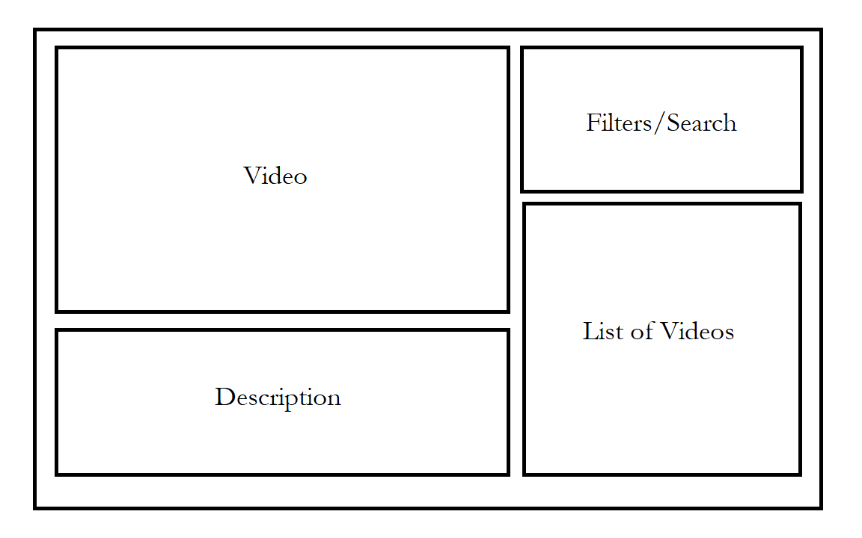
Web Page Mock-Up

Slide 7
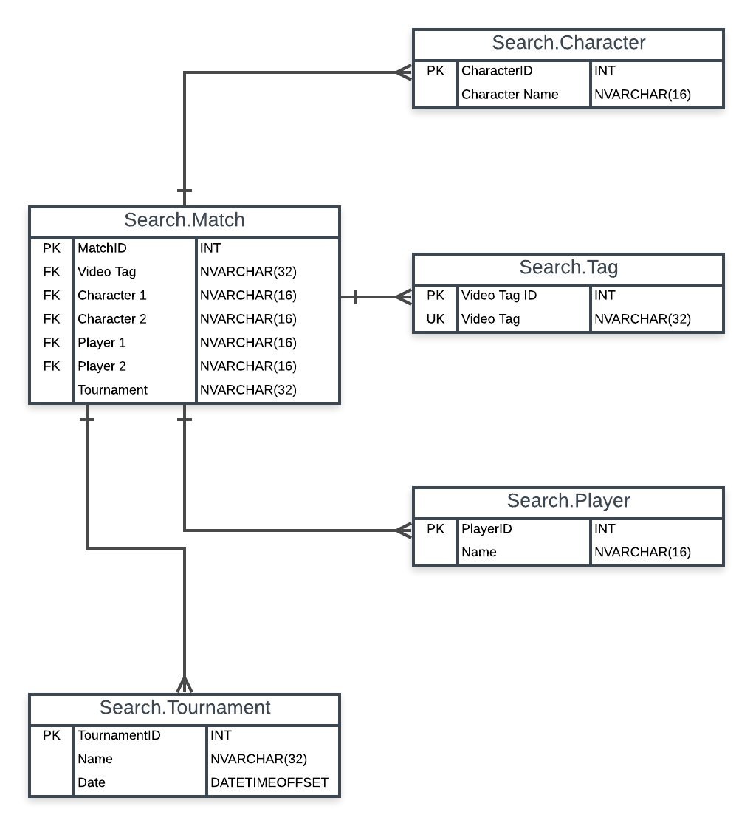
Database Design

Slide 8
Schedule
September –
Gather Data
Create Django App
Create Database
October –
Connect Django App with YT API
Continue building web page
November –
Add extra information about matches (?)
Continue refining, testing
December –
Finish testing
Final Presentation

